Slide 1
Descriptive Statistics and Exploratory Data Analysis

Slide 2
Exploratory/Descriptive Statistics
“Exploratory data analysis can never be the whole story, but nothing else can serve as the foundation stone- the first step”
John Tukey, founder of EDA “school” (1970’s)
Summarization and presentation of data
Generally one of first steps to scientific discovery
Definitely one of first steps to scientific understanding
If you can’t see it, don’t believe it!

Slide 3
Inferential/Confirmatory Statistics
Generalization of conclusions:
sample population
Assess strength of evidence
Make comparisons
Make predictions
Tools:
Modeling
Estimation and Confidence Intervals
Hypothesis Testing

Slide 4
Exploratory vs Inferential Data Analysis
Exploratory (Descriptive)
Forming ideas/hypotheses
Inferential (Confirmatory)
Investigating predefined ideas/hypotheses
Historically these approaches have been studied separately, but there is ongoing modern research into unifying them (2010 – present)

Slide 5
Types of Data
Categorical (qualitative)
1) Nominal scale - no natural order
- yes/no, nationality, gender…
2) Ordinal scale - natural order exists
- good/better/best, low/medium/high…
Numerical (quantitative)
1) Discrete - (few) integer values
- number of children in a family
2) Continuous - measure to arbitrary precision
- blood pressure, weight
Different types of data demand different analysis and graphics tools
Think: Categorise zip code

Slide 6
QUIZ
(2 mins; complete in pairs)
Categorise the following variables into nominal, ordinal, discrete, or continuous
Time since you were born
Age measured in years
Price of your lunch
Zipcode of your residence

Slide 7

Samples
In statistics we usually deal with a sample of observations or measurements. We will denote a sample of N numerical values as:
X₁, X₂, X₃,…,X_{N}
where X₁ is the first sampled datum, X₂ is the second, etc.
e.g. X₁= 60, X₂=33, X₃=41
THE ABSTRACTION
MONSTER
helps us deal with lots
of different settings at once

Slide 8
Samples
Sometimes it is useful to order the measurements. We denote the ordered sample as:
X₍₁₎, X₍₂₎, X₍₃₎,…,X_{(N)}
where X₍₁₎ is the smallest value and X_{(N)} is the largest.
X₁= 60, X₂=33, X₃=41
X₍₁₎= 33, X₍₂₎=41, X₍₃₎=60

Slide 9
Arithmetic Mean
The arithmetic mean is the most common measure of the central location of a sample. We use to refer to the mean and define it as:
The symbol Σ is shorthand for “sum” over a specified range. For example:

Slide 10
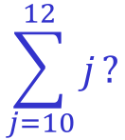
QUIZ
(2 mins; complete in pairs)
$$\sum_{j=10}^{12}{j}?$$
What is
What is the mean of -5, 10, and 0?
If I buy a bag of 3 bagels, and they weigh 85g, 95g and 90g, what is the mean weight?

Slide 11
QUIZ: part 2
(2 mins; complete in pairs)
If I buy a bag of 3 bagels, and they weigh 85g, 95g and 90g, what is the mean weight?
If I buy a bag of 3 bagels and they weigh 0.085 kg, 0.095 kg and 0.09 kg, what is the mean weight?
If I add 20 grams of cream cheese to each of my bagels, what is the mean (combined) weight of my breakfast?

Slide 12
Some Properties of the Mean
Often we wish to transform variables. Linear changes to variables impact the mean in a predictable way:
Adding a constant to all values adds that constant to the mean
Multiplication by constant multiplies the mean by that constant
CAREFUL: This does not happen for all transformations. For example, the logarithm of the mean is not the mean of the logarithms.

Slide 13
Median
Another measure of central tendency is the median - the “middle one”. Half the values are below the median and half are above. Given the ordered sample, X_{(i)}, the median is:
N odd:
N even:
Mode
The mode is the most frequently occurring value in the sample.

Slide 14
Comparison of Mean and Median
Mean is sensitive to a few very large (or small) values - “outliers”
Median is “resistant” to outliers
Mean is attractive mathematically
50% of sample is above the median,
50% of sample is below the median.
Mean/median income of this group?
Mean/median income of this group?

Slide 15
What’s the difference?
20,23,34,26,30,22,40,38,37
30,29,30,31,32,30,28,30,30

Slide 16
What’s the difference?
20,23,34,26,30,22,40,38,37
30,29,30,31,32,30,28,30,30
Variance (also called spread) is how we assess relativity in statistics

Slide 17
Measures of Spread: Range
The range is the difference between the largest and smallest observations:
Alternatively, the range may be denoted as the pair of observations:
The latter form is useful for data quality control.
Disadvantage: the sample range increases with increasing sample size.

Slide 18
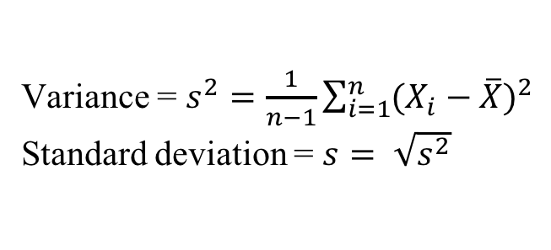
Measures of Spread: Variance
Variance = 16
Std dev = 4
Variance = 100
Std dev = 10
Most common way to assess spread: variance
Variance is a measure of the distance from each observation to the centre of the observations
Variance = $s^{2}=\frac{1}{n−1}\sum_{i=1}^{n}{{(X_{i}−\overline{X})}^{2}}$
Standard deviation = $s= \sqrt{s^{2}}$

Slide 19
QUIZ
(2 mins; complete in pairs)
If I buy a bag of 3 bagels, and they weigh 85g, 95g and 90g, what is the variance and standard deviation of the weight?
(Recall that the mean was 90g)

Slide 20
Properties of the variance/standard deviation
Variance and standard deviation are ALWAYS greater than or equal to zero.
Linear changes are a little trickier than they were for the mean:
(1) Adding a constant to all values does not change the variance or standard deviation
(2) Multiplying by a constant changes the standard deviation by that constant
(3) Multiplying by a constant changes the variance by that constant-squared
Think about: If the variance in metres was 1m², what's the variance in centimetres?

Slide 21
Measures of Spread: Quantiles and Percentiles
The median was the sample value that had 50% of the data below it.
More generally, we define the p^{th} percentile as the value which has p% of the sample values less than or equal to it.
Quartiles are the (25,50,75) percentiles. The interquartile range is Q_{.75}-Q_{.25} and is another useful measure of spread. The middle 50% of the data is found between Q_{.25} and is Q_{.75}.

Slide 22
Boxplot
A graphics display of the quartiles of a dataset, as well as the range. Extremely large or small values are also identified.
Note that this is the same data as previously plotted as a histogram:

Slide 23
Summary
Numerical Summaries
1. location - mean, median, mode.
2. spread - range, variance, standard deviation, IQR
Graphical Summaries
1. Boxplot

Slide 24
Probability Distributions
I

Slide 25
Probability: Why bother?
Most of the time we are not interested in the samples that we obtained. We are interested in using the samples to inform a more general understanding.
To understand how well our samples generalise to a broader population, we need to know how reliable/representative/variable our samples were.
Population Sample
Probability dist. Frequency dist.
Parameters Estimates

Slide 26
Probability Distribution
Definition: A random variable is a characteristic whose obtained values arise as a result of chance factors.
Definition: A probability distribution gives the probability of obtaining all possible (sets of) values of a random variable. It gives the probability of the outcomes of an experiment.

Slide 27
Theoretical Distributions
Used to provide a mathematical description of outcomes. Examples include…
A. Discrete variables
1. Binomial - sums of 0/1 outcomes
- underlies many epidemiologic applications
- basic model for logistic regression
2. Multinomial – generalization of binomial
- a basic model for log-linear analysis
B. Continuous variables
1. Normal - bell-shaped curve; many data summaries are approximately normally distributed.
2. t- distribution
3. Chi-square distribution (χ²)

Slide 28
Binomial Distribution - Motivation
Suppose a new student has joined your lab and is learning how to culture cells. Their reference letter says that 25% of the new student’s experiments fail. They only have time to create 3 cultures.
What's the probability that exactly 1 experiment fails?
What's the probability that at least 1 experiment fails?
What's the probability that all experiments succeed?

Slide 29
Bernoulli Trial
A Bernoulli trial is an experiment with only 2 possible outcomes, which we denote by 0 or 1 (e.g. coin toss)
Assumptions:
1) Two possible outcomes - success (1) or failure (0).
2) The probability of success, p, is the same for each trial.
3) The outcome of one trial has no influence on later outcomes (independent trials).

Slide 30
Binomial Random Variable
A binomial random variable is simply the total number of successes in n Bernoulli trials.
Example: number of successful experiments out of 3
To assign probabilities to outcomes of binomial random variables, we first need to know
1. How many ways are there to get k successes (k=0,…3) in n trials?
2. What’s the probability of any given outcome with exactly k successes (does order matter)?

Slide 31
Binomial Random Variable
How many ways are there to get k successes (k=0,…3) in 3 trials?
Experiments succeeding
1 2 3 Outcomes
+ + + 3 successful
+ + - 2 successful
+ - + 2 successful
- + + 2 successful
+ - - 1 successful
- + - 1 successful
- - + 1 successful
- - - 0 successful

Slide 32
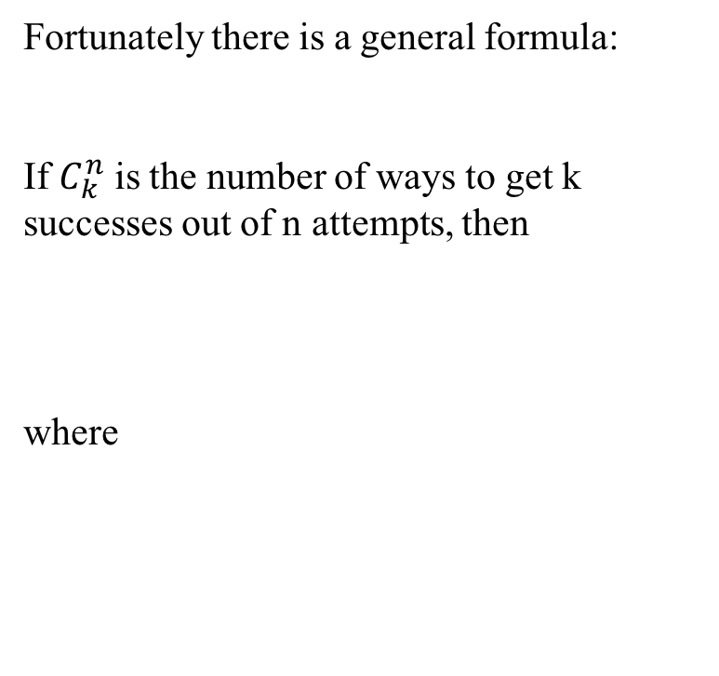
Combinations
Fortunately there is a general formula:
If $C_{k}^{n}$ is the number of ways to get k successes out of n attempts, then
where
“n factorial” = n! = n × (n-1) × … × 1

Slide 33
What are the probabilities of these outcomes?
Experiment number
1 2 3 Outcomes # ways
p p p 3 successful 1
p p 1-p 2 successful
p 1-p p 2 successful 3
1-p p p 2 successful
p 1-p 1-p 1 successful
1-p p 1-p 1 successful 3
1-p 1-p p 1 successful
1-p 1-p 1-p 0 successful 1
sequence of k +’s (0, 1, 2, or 3) and (3-k) –’s will have probability
p^{k}(1-p)^{3-k}
But there are such sequences, so in
general…

Slide 34
Binomial Probabilities
What is the probability that a binomial random variable with n trials and success probability p will yield exactly k successes?
This formula is called the probability mass function for the binomial distribution.
Assumptions:
1) Two possible outcomes - success (1) or failure (0) - for each of n trials.
2) The probability of success, p, is the same for each trial.
3) The outcome of one trial has no influence on later outcomes (independent trials).
4) The random variable of interest is the total number of successes.

Slide 36
Binomial Models
Important Assumptions:
1) Two possible outcomes - success (1) or failure (0) - for each of n trials.
2) The probability of success, p, is the same for each trial.
3) The outcome of one trial has no influence on later outcomes (independent trials).
4) The random variable of interest is the total number of successes.

Slide 37
Quiz: 6 mins
Suppose a new student has joined your lab and is learning how to culture cells. Their reference letter says that 25% of the new student’s experiments fail. They only have time to create 3 cultures.
What's the probability that exactly 1 experiment fails?
What's the probability that at least 1 experiment fails?
What's the probability that all experiments succeed?
Recall:
where, e.g., 4! = 4 x 3 x 2 x 1 = 24

Slide 38
Quiz Qtn 1: solution
What's the probability that exactly 1 experiment fails?
X = number of failures
“X is distributed as binomial”

Slide 39
Mean and Variance of a Discrete Random Variable
Given a theoretical probability distribution we can define the mean and variance of a random variable which follows that distribution. These concepts are analogous to the summary measures used for samples except that these now describe the value of these summaries in the limit as the sample size goes to infinity (i.e. the parameters of the population).
Suppose a random variable X can take the values {x₁,x₂,…} with probabilities {p₁,p₂,…}. Then
MEAN:
VARIANCE:

Slide 40
Example - Mean and Variance
Consider a Bernoulli random variable with success probability p.
P[X=1] = p
P[X=0]=1-p
MEAN:
VARIANCE

Slide 41
Mean and Variance - Binomial
Consider a binomial random variable with success probability p and sample size n.
X ~ bin(n,p)
MEAN:
VARIANCE:
Help!

Slide 42
Means and Variance of the Sum of independent RV’s
Recall that a binomial RV is just the sum of n independent Bernoulli random variables.
If X₁, X₂, …,X_{n} are independent random variables …
1. Means add:
E[X₁+ X₂+ …+X_{n}] = E[X₁]+E[X₂]+ …+E[X_{n}]
2. Variances add:
V[X₁+ X₂+ …+X_{n}] = V[X₁]+V[X₂]+ …+V[X_{n}]
We can use these results, together with the properties of the mean and variance that we learned earlier, to obtain the mean and variance of a binomial random variable (Exercise 3).

Slide 43
Binomial Distribution Summary
Binomial
1. Discrete, bounded
2. Parameters - n,p
3. Sum of n independent 0/1 outcomes
4. Sample proportions, logistic regression

Slide 44
Exercises
The current powerball jackpot is $140 million, and your probability of winning it is 1 in 175 million. If it costs $2 to play, what is your expected payoff?
A couple intends to have 5 children and both are carriers of myotonic dystrophy, a dominant trait. What is the probability that at least 1 child will have the trait?
Calculate the mean and variance of a binomially distributed random variable with n trials and success probability p.

Slide 45
Ex 1. Solution
X = Powerball payoff in dollars
There are 2 possible values for X: X= 140000000-2 (which occurs with probability 1/175000000), and X= -2 (occurs with probability 1-1/175000000).
EX = (140000000-2)*1/175000000 +
-2*(1-1/175000000) = -1.2
So the expected payoff is a loss of $1.20

Slide 46
Ex 2. Solution
The probability of any single child having the trait is 0.75, and the carrier status of each child is independent of every other. The number of children with the trait (X) is therefore a binomially-distributed random variable with n = 5 and p = 0.75.

Slide 47
Ex 3. Solution
If X ~ Bin(n,p) and Y1, Y2…Yn are independent Bernoulli random variables with success probability p, then X has the same distribution as Y1 + Y2 + … + Yn. So

